Slide 1


Tutorial Presentation Title: Restaurant Sentiment Analysis Software Tutorial Author: Hiranmayi Palanki (palanki2@Illinois.edu)
Notes:
Hello, welcome to the Tutorial on Restaurant Sentiment Analysis Software. I'm Hiranmayi Palanki, the author of this tutorial and the associated software.

Slide 2
Agenda
Introduction
Requirements
Installation
Running the Software – Jupyter Notebook
Running the Software – Python Script
Using the Prediction Function
Example Use Case
Conclusion
Thank You
Model Training
Notes:
For the agenda of this presentation, I'll begin with an introduction to the sentiment analysis software. Cover the requirements to run the software. Review the installation steps, and how to run the software. I'll then review the model training process, using the prediction function and cover an example use case. I'll then close with the conclusion and a thank you message.

Slide 3

Introduction to Sentiment Analysis Software
In this session, we’ll explore a powerful tool designed to analyze and understand the sentiments expressed in restaurant reviews.
Sentiment analysis plays a crucial role in deciphering the emotions and opinions conveyed in textual data. In the context of restaurant reviews, it allows us to uncover valuable insights into customer experiences.
This software leverages machine learning techniques to predict sentiment categories – Negative, Neutral, or Positive – based on the content of restaurant reviews.
Key features of this software include data preprocessing, machine learning model training, and a user-friendly prediction function. You can explore the code in a Jupyter Notebook or run a script for direct execution.

Slide 4
Requirements
Python 3.x
Jupyter Notebook
Required Python packages: pandas, numpy, matplotlib, seaborn, scikit-learn, wordcloud, pickle
Notes:
There are 3 requirements to run this software. They are Python 3.x, Jupyter Notebook and several required python packages as listed on the slide.

Slide 5
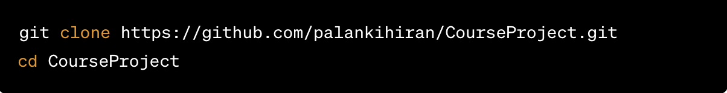
Installation
Clone the repository:
Install required packages:
Notes:
The installation steps are to clone the repository and to install the required packages.

Slide 6
Running the Software – Jupyter Notebook
Open Jupyter Notebook:
jupyter notebook
Navigate to `Sentiment_Analysis.ipnyb`
Run each cell to observe step-by-step execution.
Note: `data_cleaned.zip` should be extracted in the same folder as the Jupyter notebook. The extracted zip file contains two .csv files namely, `GoogleReview_data_cleaned.csv` and `TripAdvisor_data_cleaned.csv`.
Notes:
Steps to run the software with Jupyter notebook are listed here.

Slide 7
Running the Software – Python Script
Open a terminal or command prompt. Navigate to the project directory:
Ensure model.pkl, tokenizer.pkl are in the same root folder as the python script. Then run the script:
Notes:
Steps to run the software with the Python script are listed here.

Slide 8
Model Training
Feature Extraction
TF-IDF is utilized for feature extraction.
Model Input
TF-IDF vector is provided as input to the model along with the label.
Model Output
Predicts the sentiment of the given text along with the probability / confidence of the prediction.
Notes:
Steps to train the model are depicted on this slide.

Slide 9
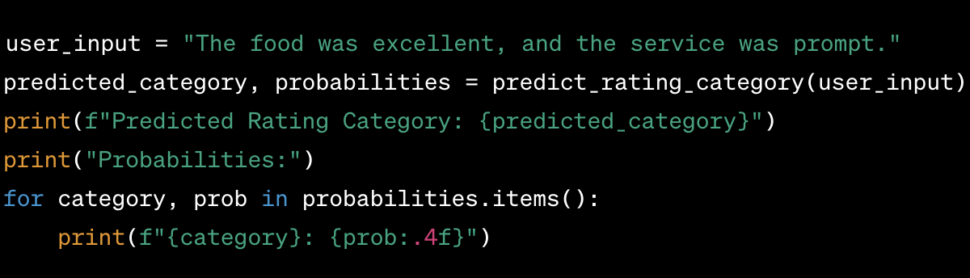
Using the Prediction Function
1. Import the function:
2. Use the function with a user input:
Notes:
Steps to use the prediction function are listed here.

Slide 10
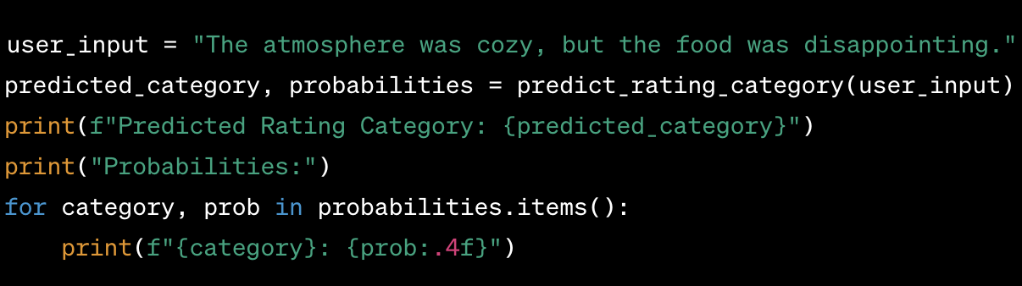
Example Use Case
Demonstrates a real-world example using the prediction function:

Slide 11
Conclusion
In conclusion, we covered the installation steps, methods for running the software, reviewed the prediction function, and demonstrated a practical use case.
Whether you're a data scientist or an ML engineer, this sentiment analysis software is a valuable tool for discerning restaurant reviews.

Slide 12

Thank You
I would like to extend my sincere gratitude to my fellow students, teaching assistants and to the class professor who have been part of this learning journey.

